Slide 1
ARME Analysis Summary
~ Ria Das ~

Slide 2

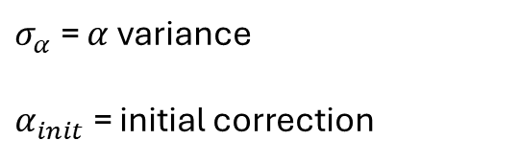


Current Model & Parameters to Optimise
Deviation $s$ = IOI $r$ – internal timekeeper $T$
$$s_{i,n}=r_{i,n}−T_{i,n}=−\sum_{j=1, j≠i}^{K}{α_{ij}A_{ij,n−1}}+ε_{i,n}$$
$$a_{ij,n}=a_{ij,n−1}+w_{ij,n}$$
Hidden variable
$σ_{v}$ = observation noise
Observed variable
$σ_{w}$ = process noise
$σ_{α}$ = $α$variance
$α_{init}$ = initial correction

Slide 3

Current Model & Parameters to Optimise
Deviation $s$ = IOI $r$ – internal timekeeper $T$
$$s_{i,n}=r_{i,n}−T_{i,n}=−\sum_{j=1, j≠i}^{K}{α_{ij}A_{ij,n−1}}+ε_{i,n}$$
$$a_{ij,n}=a_{ij,n−1}+w_{ij,n}$$
Hidden variable
$σ_{v}$ = observation noise
Observed variable
$σ_{w}$ = process noise
$σ_{α}$ = $α$variance
$α_{init}$ = initial correction

Slide 4

Current Model & Parameters to Optimise
Deviation $s$ = IOI $r$ – internal timekeeper $T$
$$s_{i,n}=r_{i,n}−T_{i,n}=−\sum_{j=1, j≠i}^{K}{α_{ij}A_{ij,n−1}}+ε_{i,n}$$
$$a_{ij,n}=a_{ij,n−1}+w_{ij,n}$$
Hidden variable
$σ_{v}$ = observation noise
Observed variable
$σ_{w}$ = process noise
$σ_{α}$ = $α$variance
$α_{init}$ = initial correction

Slide 5

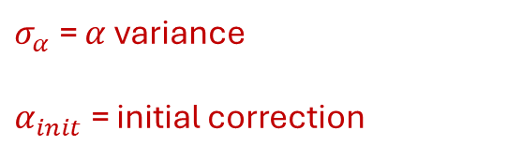
Current Model & Parameters to Optimise
Deviation $(s)$ = IOI $(r)$ – internal timekeeper $(T)$
$$s_{i,n}=r_{i,n}−T_{i,n}=−\sum_{j=1, j≠i}^{K}{α_{ij}A_{ij,n−1}}+ε_{i,n}$$
$$a_{ij,n}=a_{ij,n−1}+w_{ij,n}$$
Hidden variable
$σ_{v}$ = observation noise
Observed variable
$σ_{w}$ = process noise
$σ_{α}$ = $α$variance
$α_{init}$ = initial correction

Slide 6
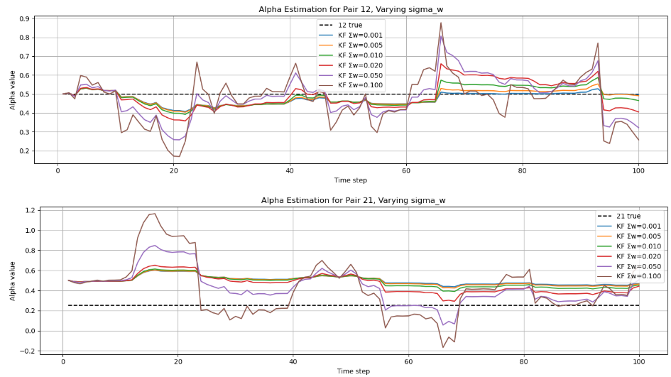
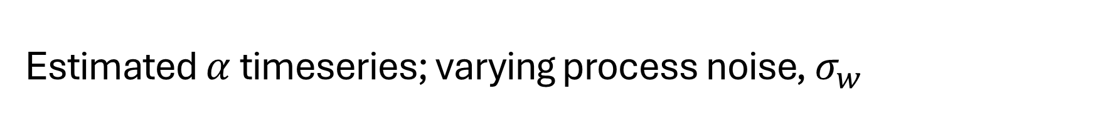
Estimated $α$ timeseries; varying process noise, $σ_{w}$

Slide 7

Estimated $α$ timeseries; varying process noise, $σ_{w}$
↑ $σ_{w}$ : more noise, less bias

Slide 8
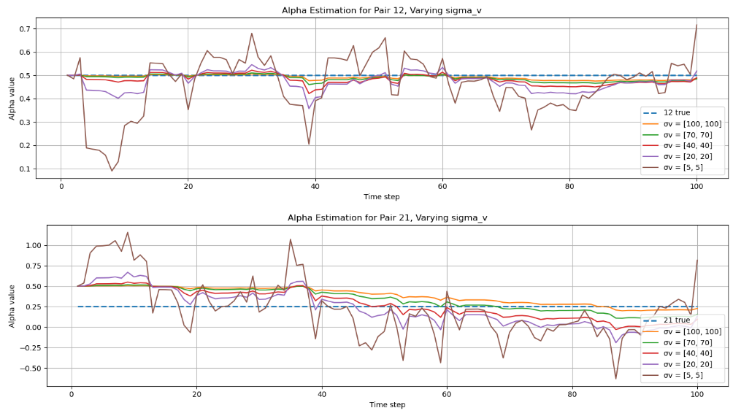
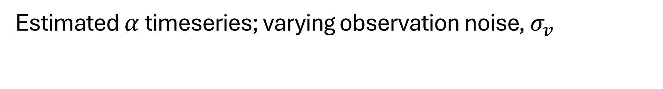
Estimated $α$ timeseries; varying observation noise, $σ_{v}$

Slide 9

Estimated $α$ timeseries; varying observation noise, $σ_{v}$
↑ $σ_{v}$ : less noise, more bias

Slide 10
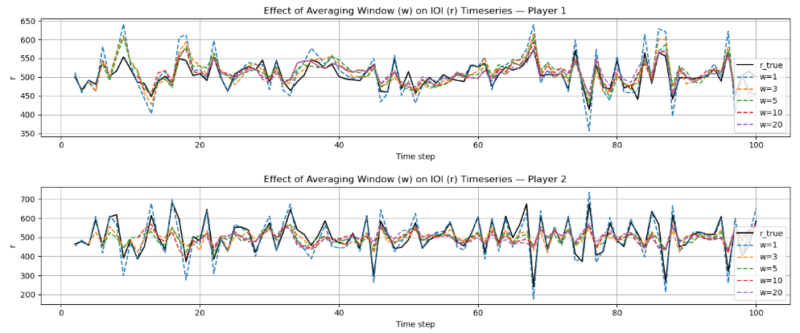
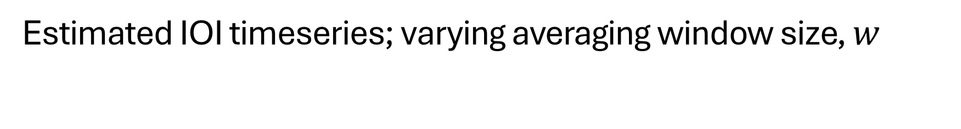
Estimated IOI timeseries; varying averaging window size, $w$

Slide 11
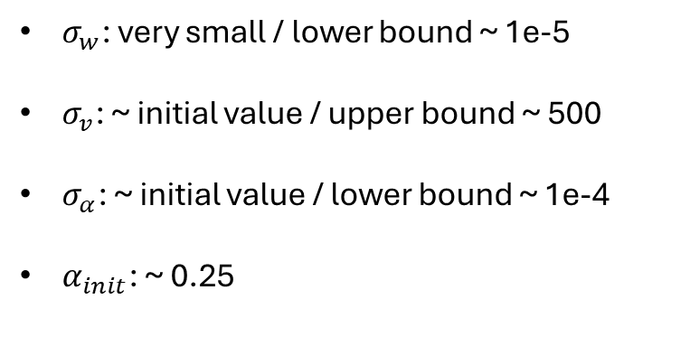
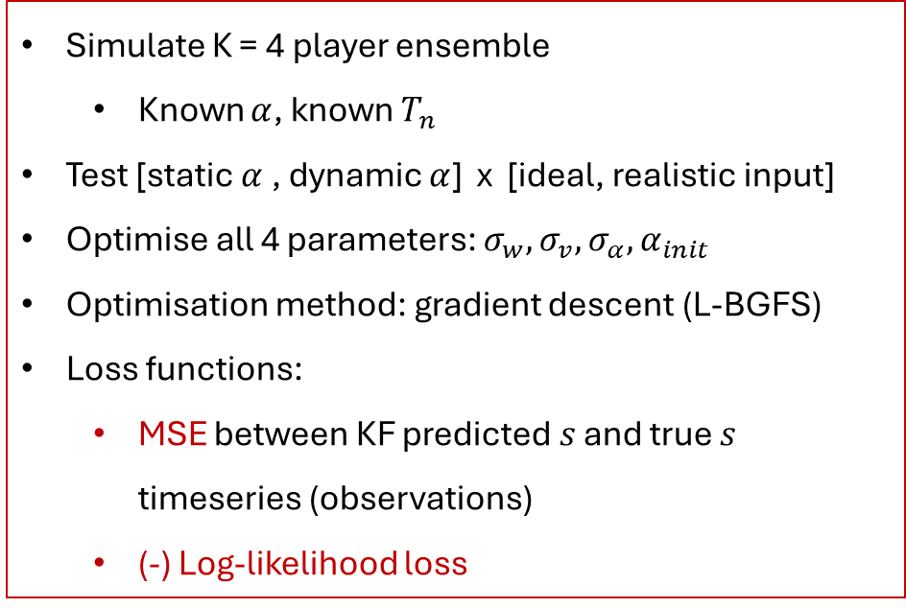
Optimising Artificial Data
Results
Simulate K = 4 player ensemble
Known $α$, known $T_{n}$
Test [static $α$ , dynamic $α$] x [ideal, realistic input]
Optimise all 4 parameters: $σ_{w},σ_{v},σ_{α}, α_{init}$
Optimisation method: gradient descent (L-BGFS)
Loss functions:
MSE between KF predicted $s$ and true $s$ timeseries (observations)
(-) Log-likelihood loss
$σ_{w}$: very small / lower bound ~ 1e-5
$σ_{v}$: ~ initial value / upper bound ~ 500
$σ_{α}$: ~ initial value / lower bound ~ 1e-4
$α_{init}$: ~ 0.25

Slide 12
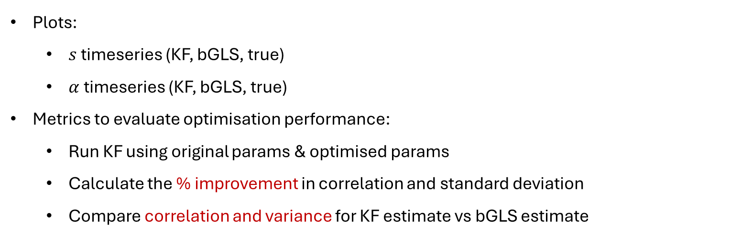
Optimising Artificial Data
Plots:
$s$ timeseries (KF, bGLS, true)
$α$ timeseries (KF, bGLS, true)
Metrics to evaluate optimisation performance:
Run KF using original params & optimised params
Calculate the % improvement in correlation and standard deviation
Compare correlation and variance for KF estimate vs bGLS estimate

Slide 13
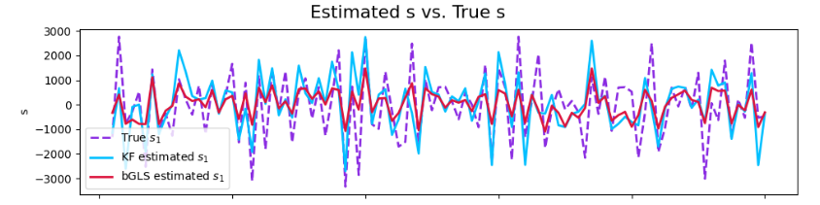
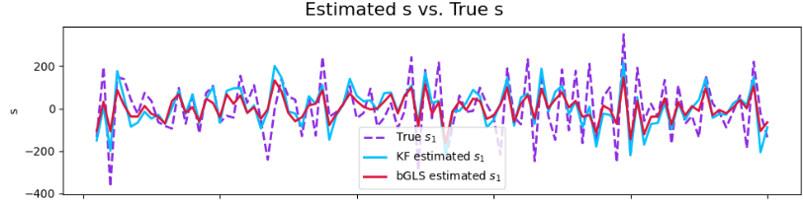
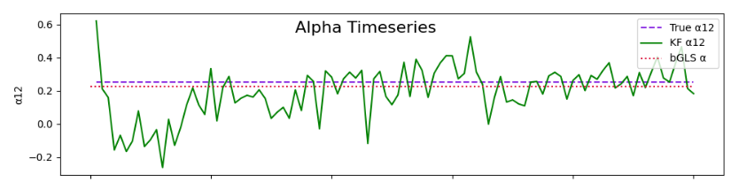
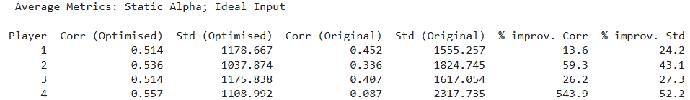
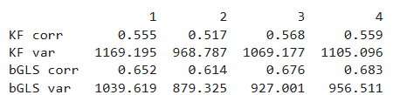
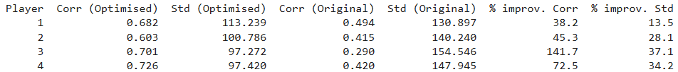
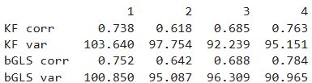
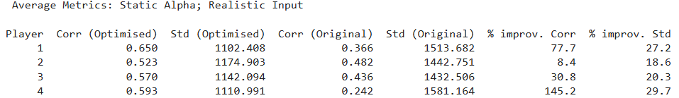
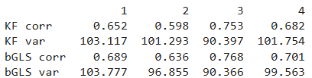
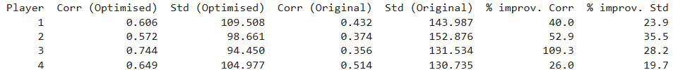
Cases1 & 2: Static Alpha, Ideal / Realistic Input
Correlation ~ 0.6 – 0.7
Significant improvement in correlation
bGLS > KF

Slide 14
Cases1 & 2: Static Alpha, Ideal / Realistic Input
Correlation ~ 0.6 – 0.7
Significant improvement in correlation
bGLS > KF

Slide 15
Cases1 & 2: Static Alpha, Ideal / Realistic Input
Correlation ~ 0.6 – 0.7
Significant improvement in correlation
bGLS > KF

Slide 16
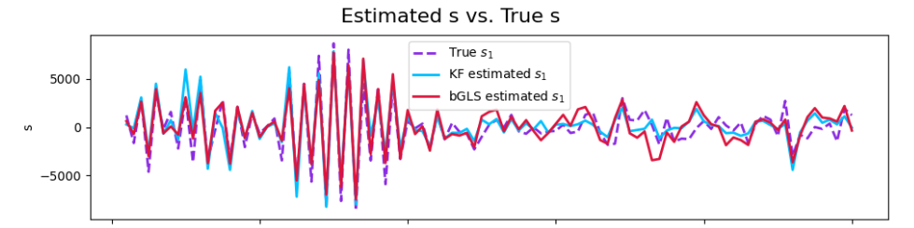
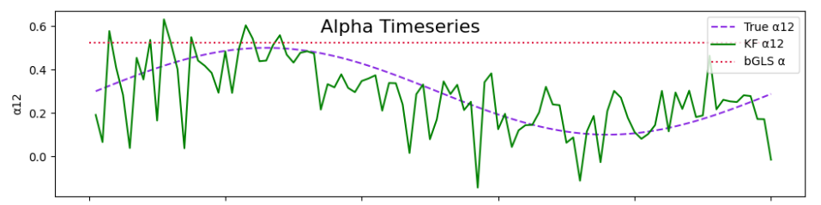
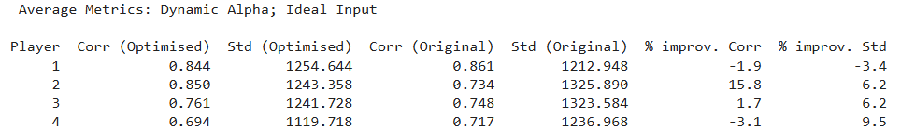
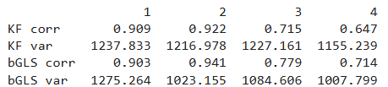
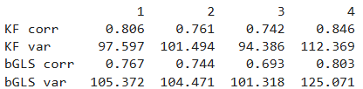
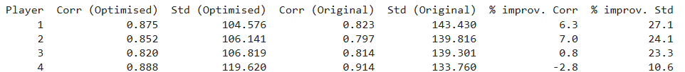
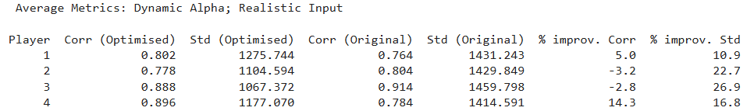

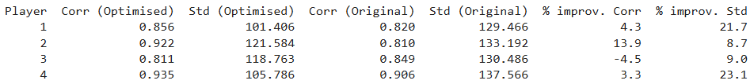
Cases 3 & 4: Dynamic Alpha, Ideal / Realistic Input
Correlation ~ 0.8 – 0.9
Less significant improvement in correlation
bGLS < KF

Slide 17
Cases 3 & 4: Dynamic Alpha, Ideal / Realistic Input
Correlation ~ 0.8 – 0.9
Less significant improvement in correlation
bGLS < KF

Slide 18
Cases 3 & 4: Dynamic Alpha, Ideal / Realistic Input
Correlation ~ 0.8 – 0.9
Less significant improvement in correlation
bGLS < KF

Slide 19
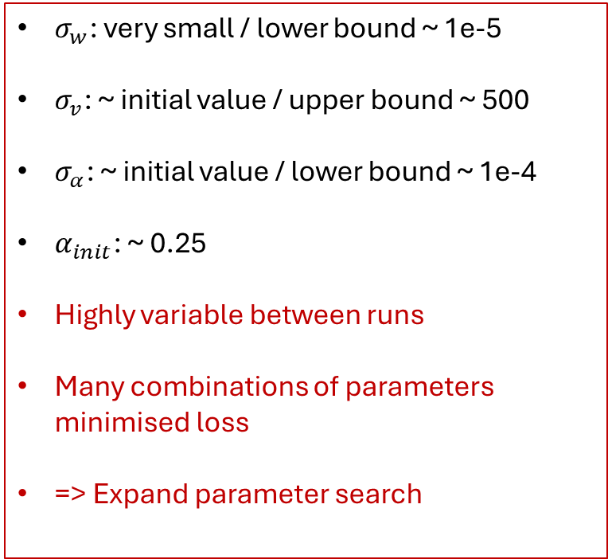
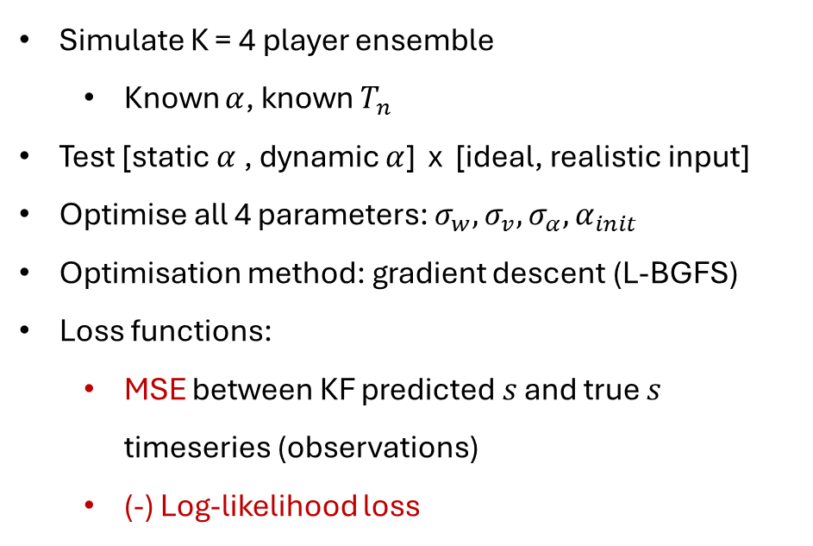
Optimising Artificial Data
Results
Simulate K = 4 player ensemble
Known $α$, known $T_{n}$
Test [static $α$ , dynamic $α$] x [ideal, realistic input]
Optimise all 4 parameters: $σ_{w},σ_{v},σ_{α}, α_{init}$
Optimisation method: gradient descent (L-BGFS)
Loss functions:
MSE between KF predicted $s$ and true $s$ timeseries (observations)
(-) Log-likelihood loss
$σ_{w}$: very small / lower bound ~ 1e-5
$σ_{v}$: ~ initial value / upper bound ~ 500
$σ_{α}$: ~ initial value / lower bound ~ 1e-4
$α_{init}$: ~ 0.25
Highly variable between runs
Many combinations of parameters minimised loss
=> Expand parameter search

Slide 20
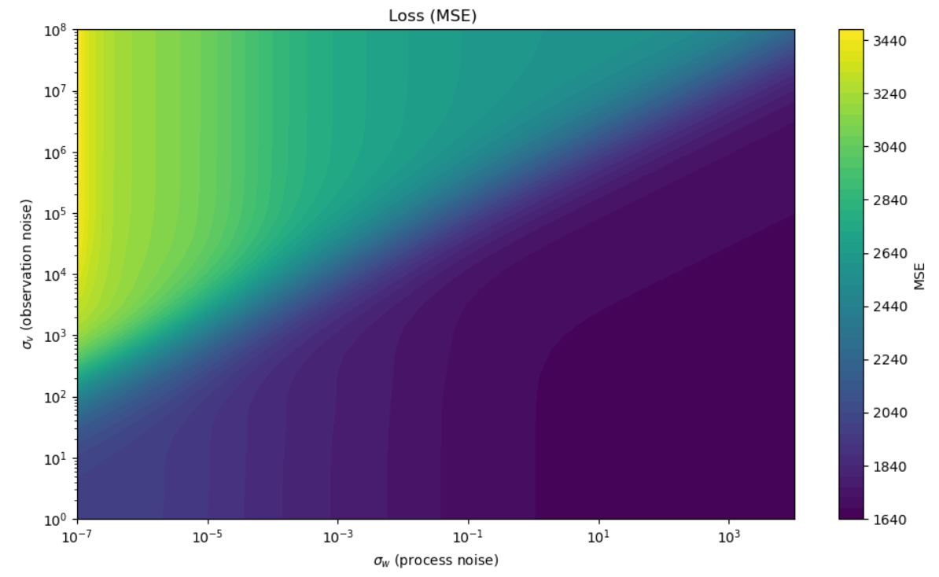
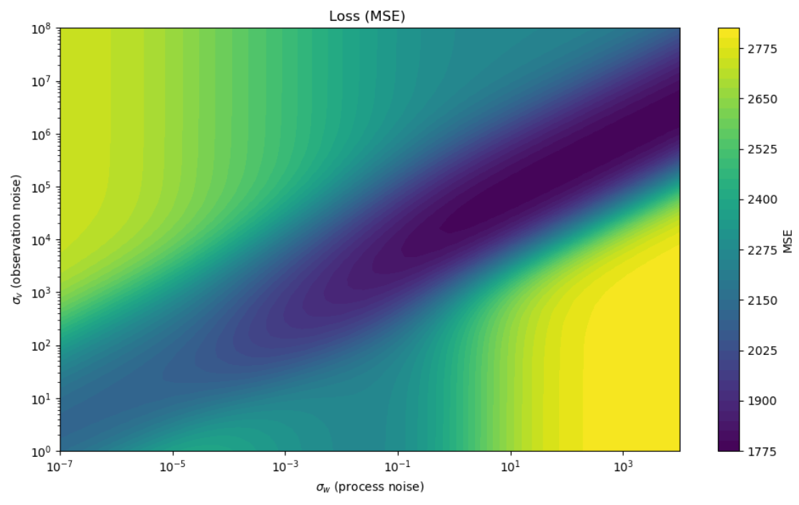
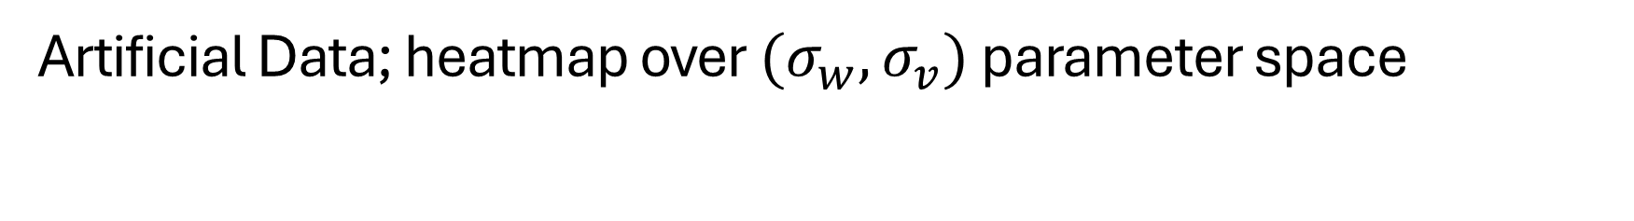
Artificial Data; heatmap over ${(σ}_{w},σ_{v})$ parameter space
Static True Alpha
Dynamic True Alpha

Slide 21
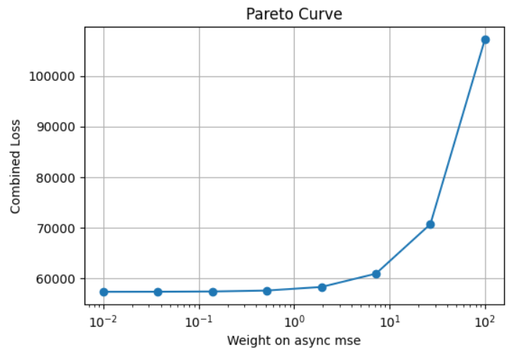

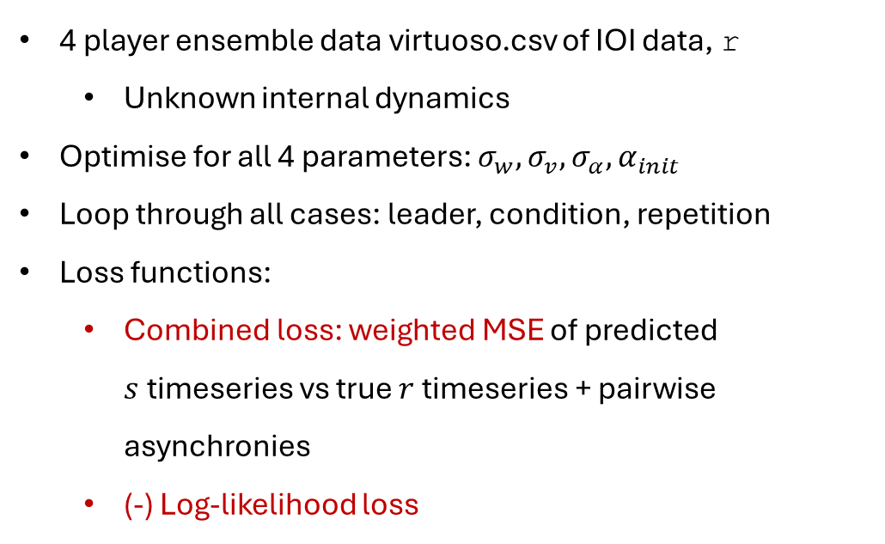
Optimising Real Data
4 player ensemble data virtuoso.csv of IOI data, r
Unknown internal dynamics
Optimise for all 4 parameters: $σ_{w},σ_{v},σ_{α}, α_{init}$
Loop through all cases: leader, condition, repetition
Loss functions:
Combined loss: weighted MSE of predicted $s$timeseries vs true $r$ timeseries + pairwise asynchronies
(-) Log-likelihood loss
obj_comb = mse_s + $λ$ * mse_async

Slide 22
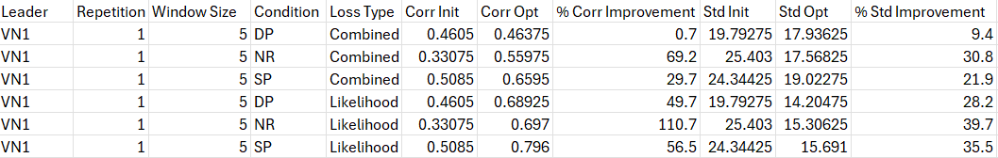
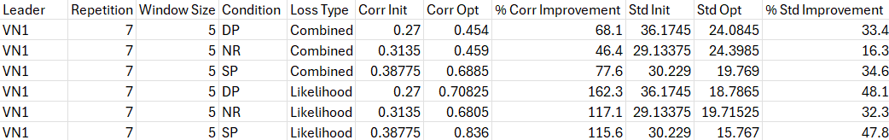
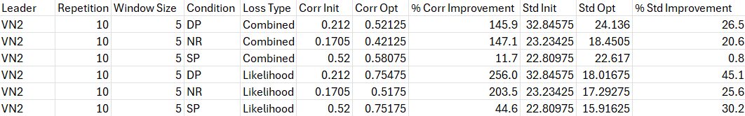
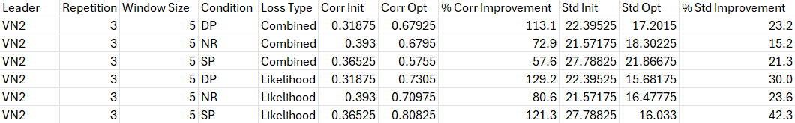
Optimising Real Data
Evaluating effect of optimisation on correlation

Slide 23
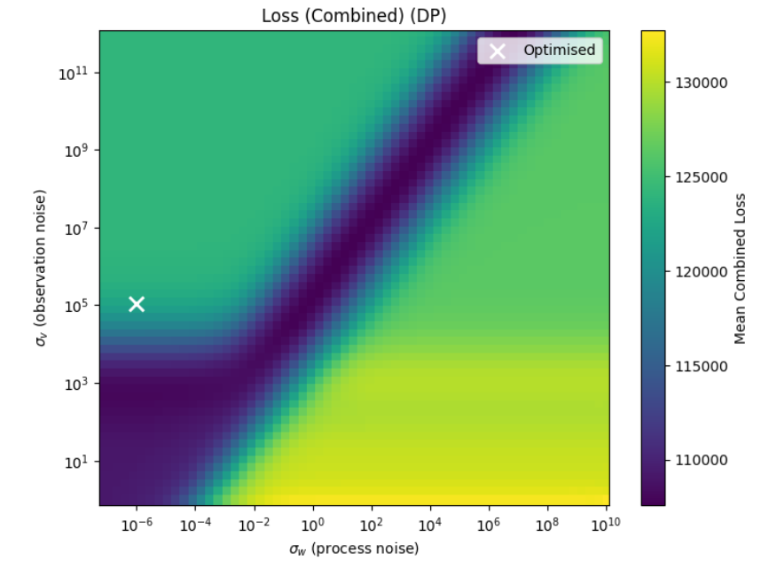
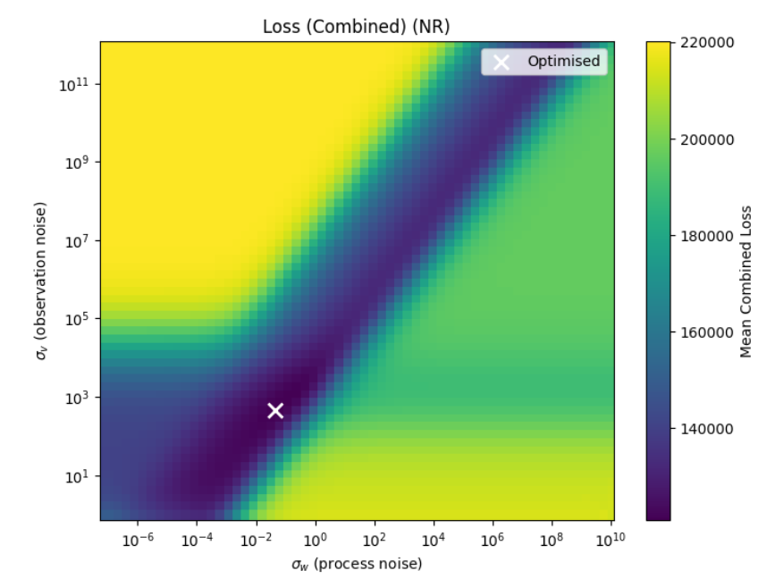
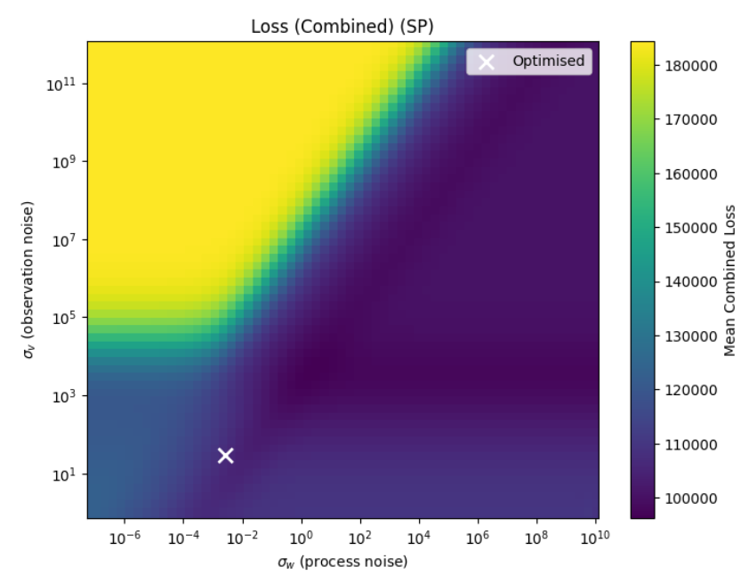
Real data heatmaps for each condition, over ${(σ}_{w},σ_{v})$

Slide 24


Real data heatmaps for each condition, over ${(σ}_{w},σ_{v})$
Artificial: dynamic $α$
Artificial: static $α$
Notes:
Faster playing -> more static alpha for each player (less reactive playing)

Slide 25
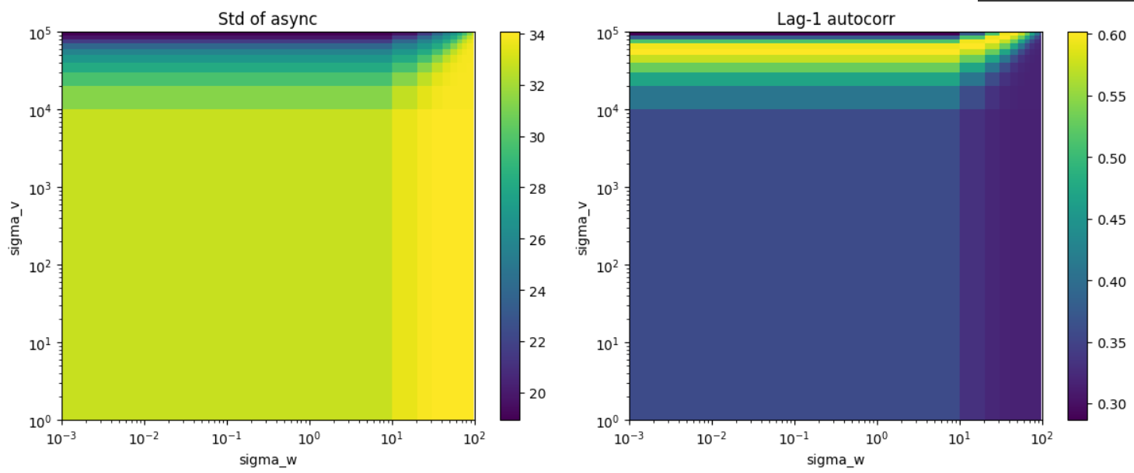
Harry, B., Keller, P.E. Tutorial and simulations with ADAM: an adaptation and anticipation model of sensorimotor synchronization. Biol Cybern 113, 397–421 (2019)
Real data heatmaps over ${(σ}_{w},σ_{v})$
Standard Deviation of Asynchronies
Lag-1 Autocorrelation

Slide 26
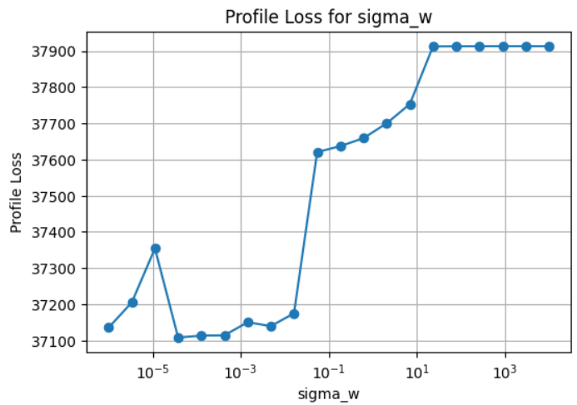
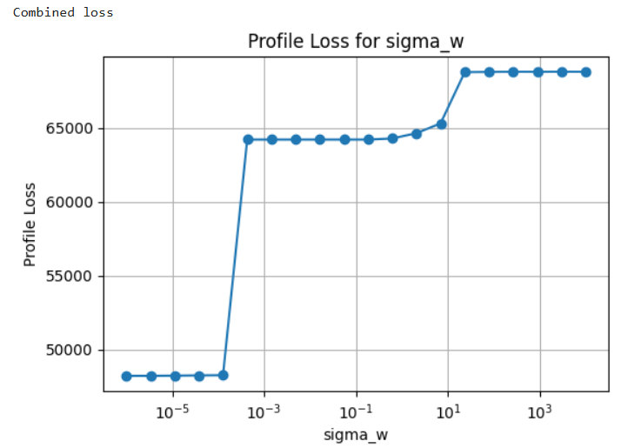
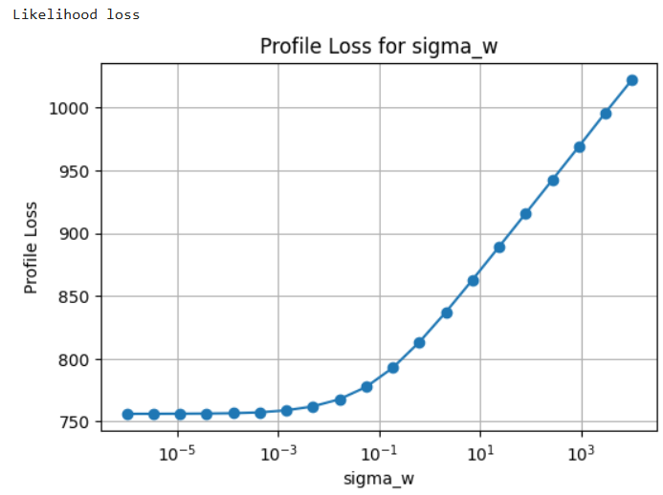
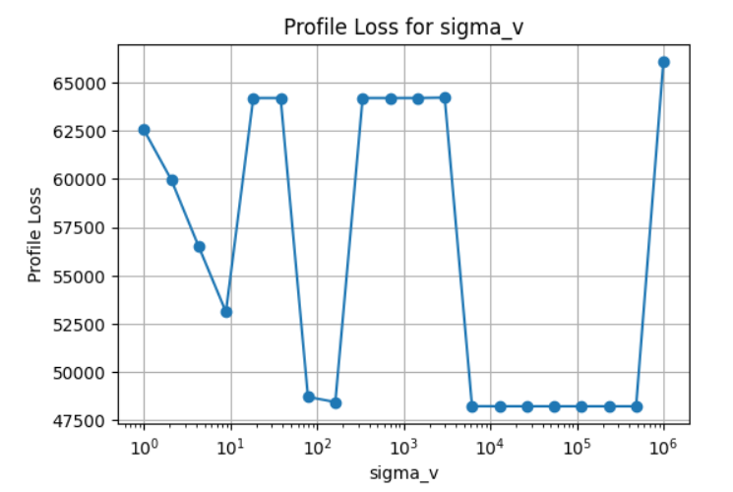


Profile loss plots

Slide 27
Profile loss plots
Combined
Log-likelihood

Slide 28




Profile loss plots
Combined
Log-likelihood

Slide 29

Conclusions
The model is not overly sensitive to initial choice of noise parameters
Optimisation is more flexible
Optimisation improves correlation between predicted and observed data significantly
Suggestions:
Fix $α_{init}$ at 0.25 or 0
Fix either $σ_{v}$ or $σ_{w}$
Optimise other params $σ_{α},(σ_{w} or σ_{v})$ using some calibration data (e.g. 10 IOIs)
Look into instability of asynchrony variability, extreme cases
Further explanation of the profile loss plots
SP condition heatmap

